Slide 1



Power Management System
Using ESP_32, CT, PT, Oled display and Blynk Integration
Presenting By
Abdullah Nazmus-Sakib (CSE)
Omar Faruk (Chemistry)

Slide 2
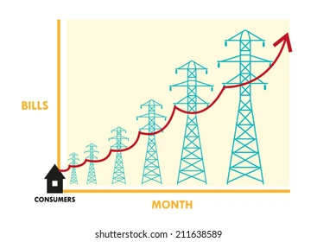

Why Power Management System nedded?
Rising electricity bills due to inefficient energy use.
Lack of real-time monitoring and analysis.
Need for energy-efficient solutions.

Slide 3

The Problem
Many households and businesses struggle with high electricity bills due to inefficient energy use. Users need a way to monitor their energy consumption in real-time to make informed decisions about energy use.
High energy wastage due to uninformed usage.
No visibility into device-level energy consumption.
Difficulty in optimizing energy use without real-time data.

Slide 4

The Solution
A Smart Power Management System that uses CT and PT to measure voltage and current, calculate the power consumption of electrical devices, and estimate the cost based on usage. This system will provide real-time data through a web interface accessible via a smartphone or computer.
A system to monitor energy usage in real time.
Power consumption and cost estimation using CT and PT sensors.
Accessible data via a smartphone or computer.

Slide 5
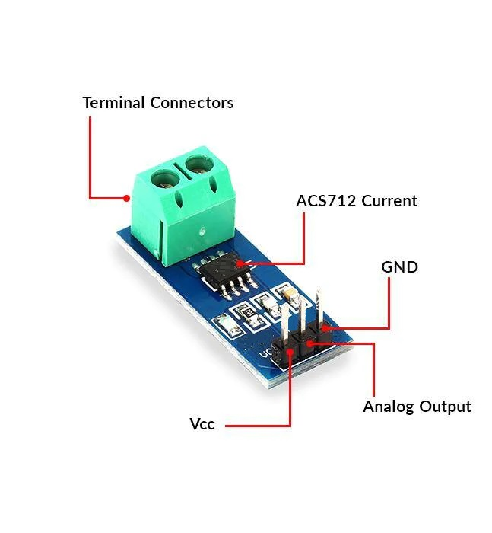
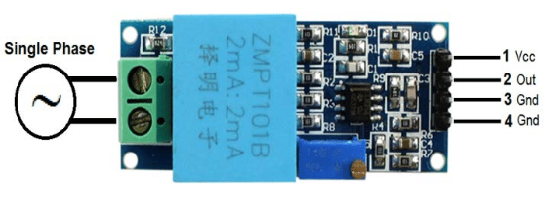
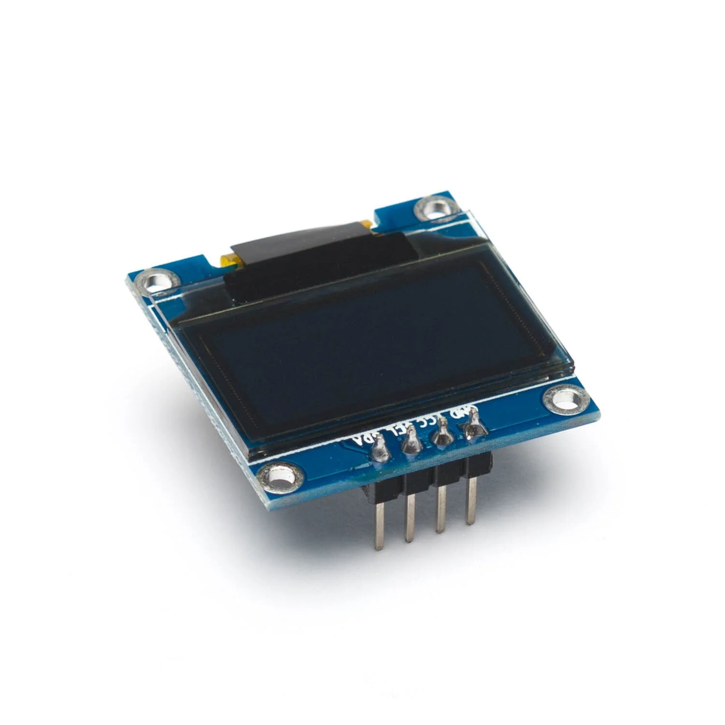
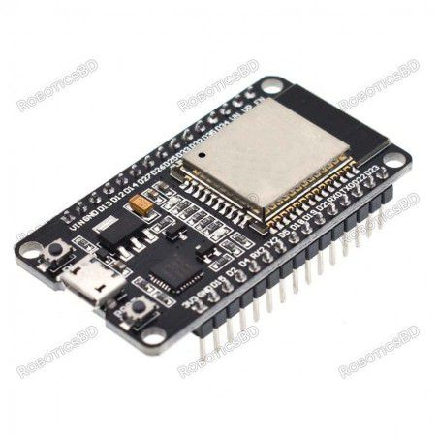
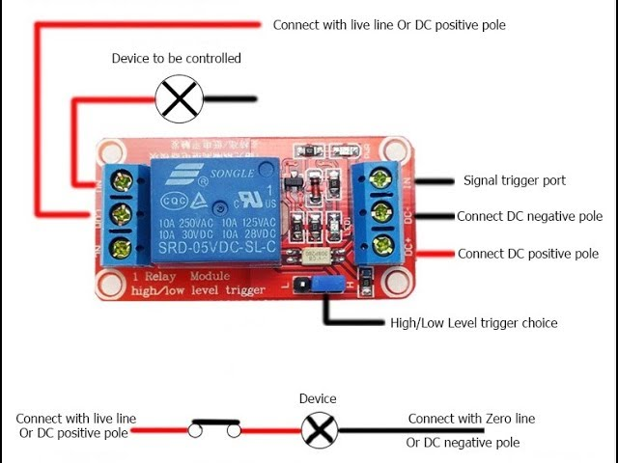
System Component
Key Components:
1. ESP32 (NodeMCU)
2. Current Transformer (CT) as ACS 712 30A
3. Potential Transformer (PT) As ZMPT101B
4. Oled display (0.96’’)
5. Relay Module

Slide 6
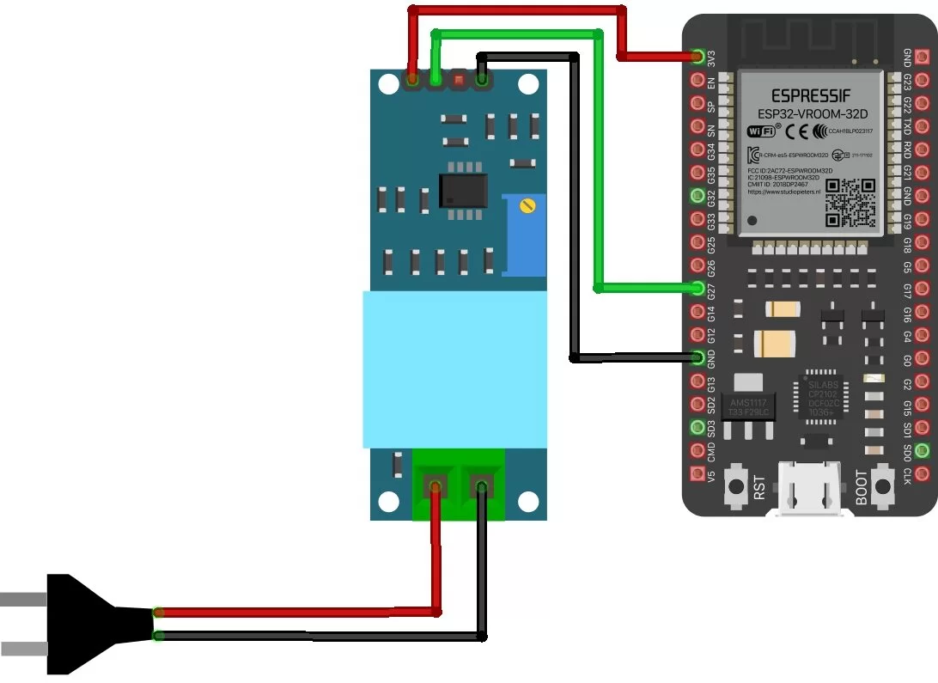
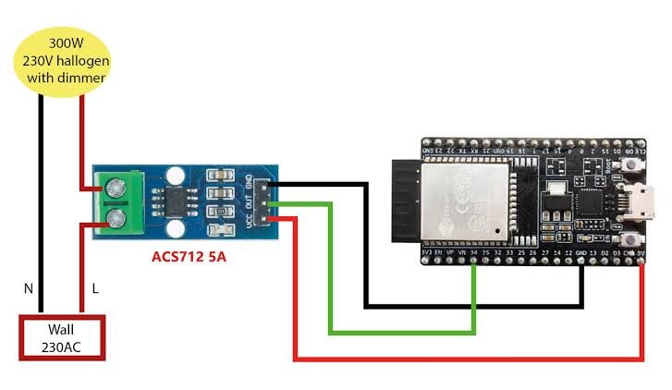
System Workflow
1. CT measures current.
2. PT measures voltage.
3. NodeMCU calculates power and cost.
4. Data is displayed locally or on the web.

Slide 7
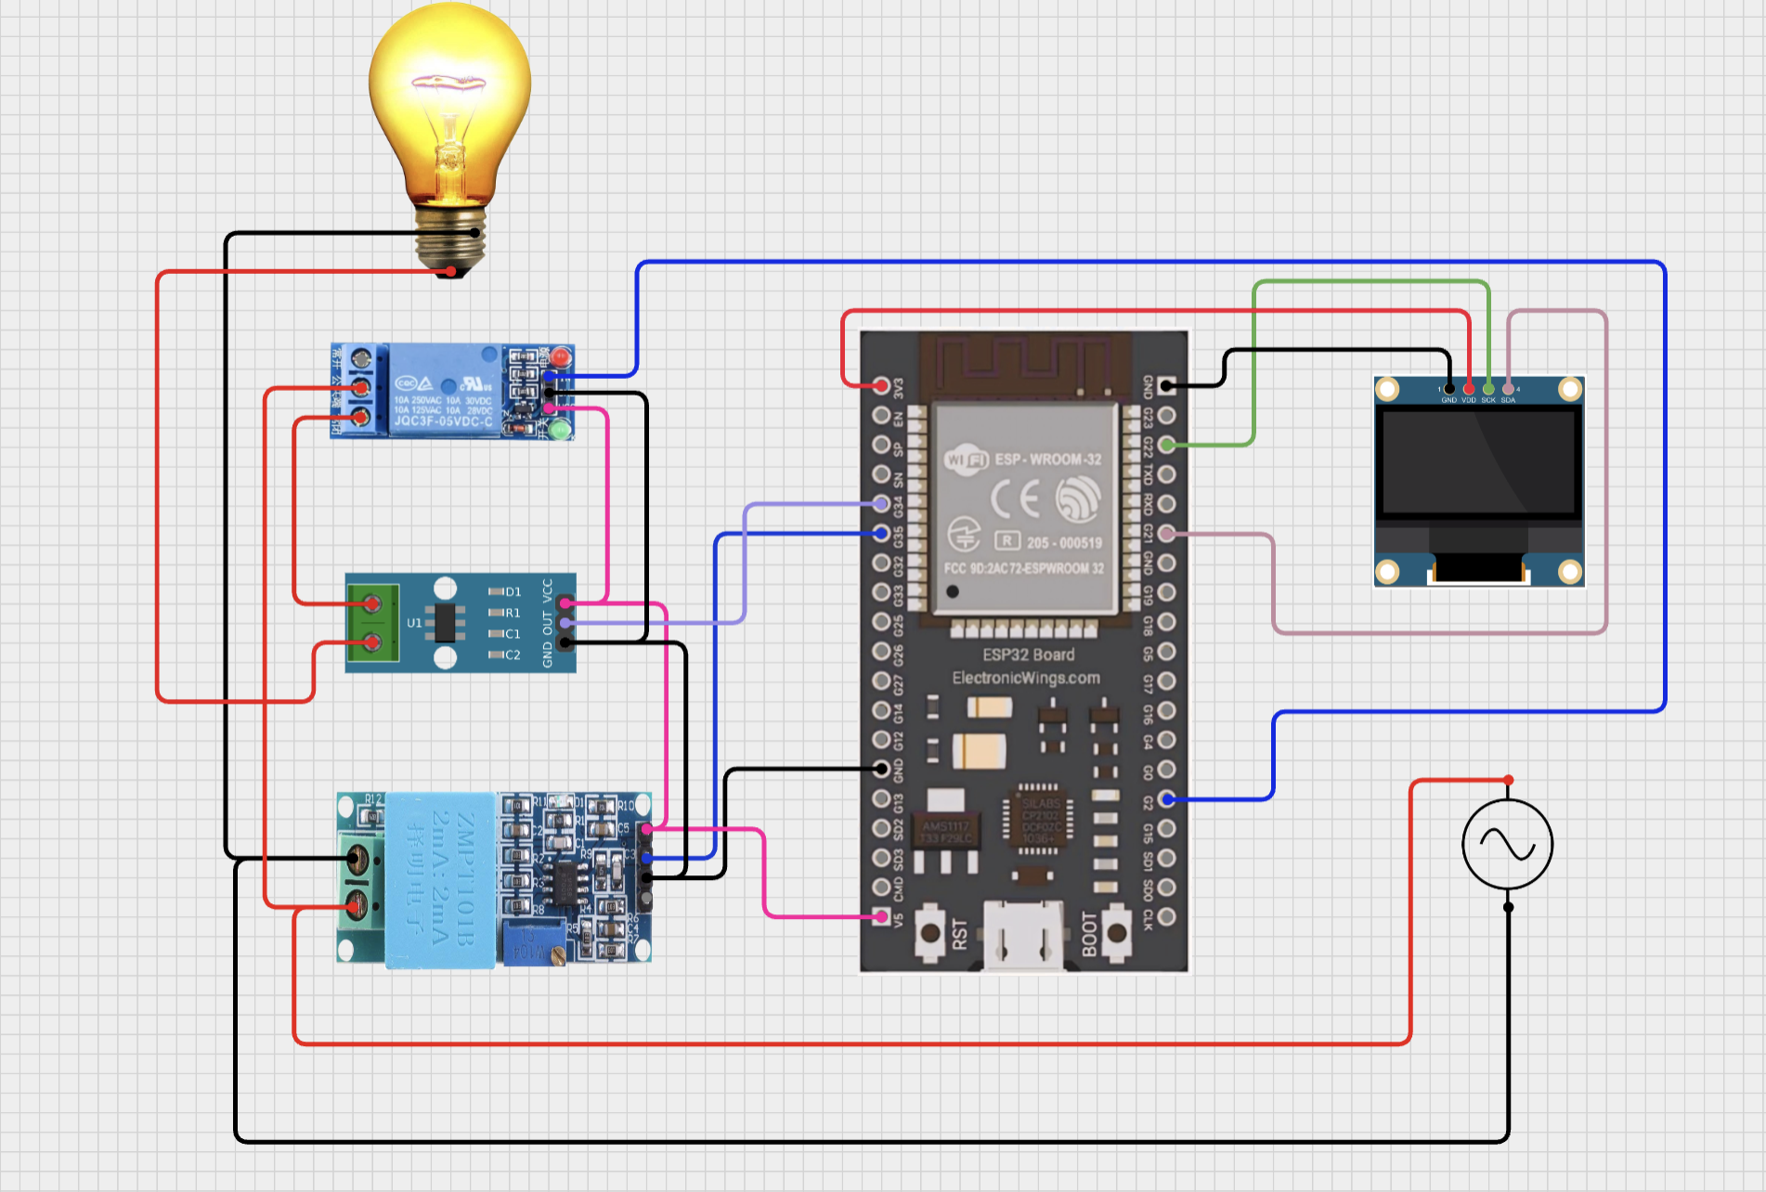
Implementation Steps
Circuit assembly using CT, PT, NodeMCU, and optional modules.
Programming using Arduino IDE to process data and send it to the cloud.
Calibration of sensors for accurate measurements.
Data visualization on Blynk

Slide 8
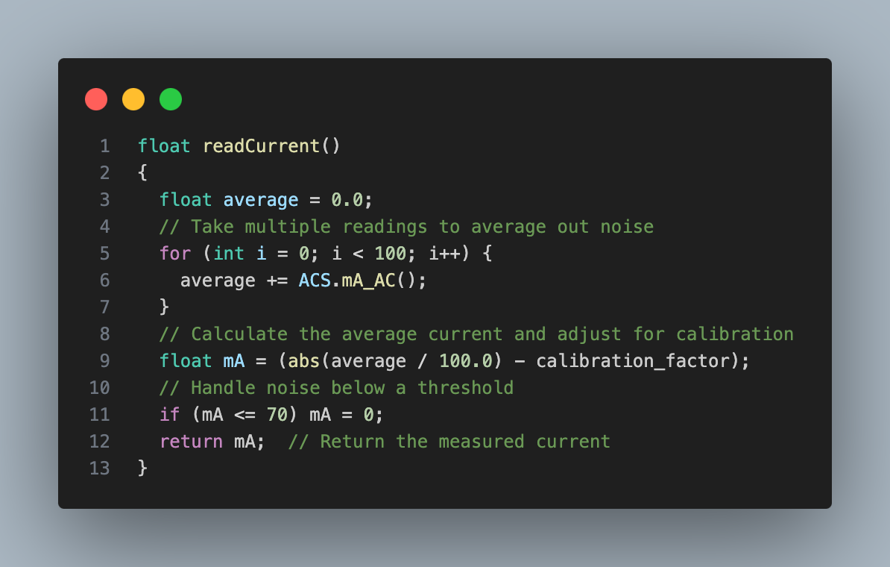
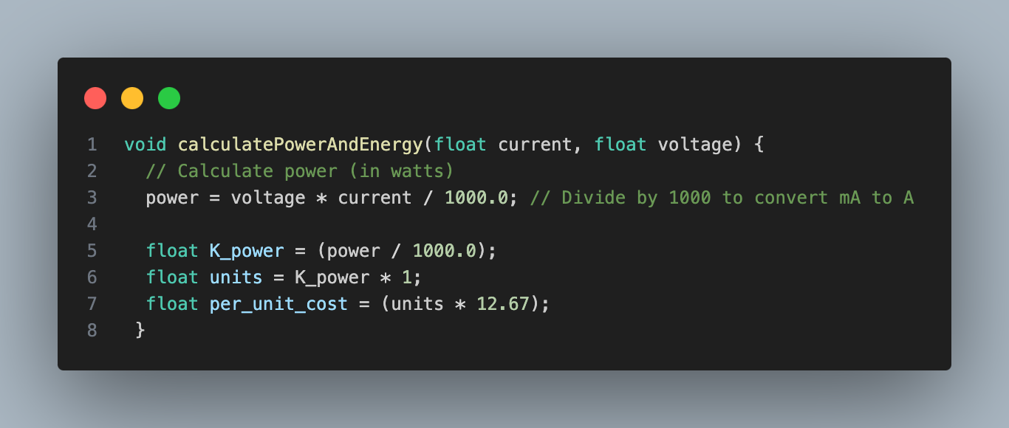
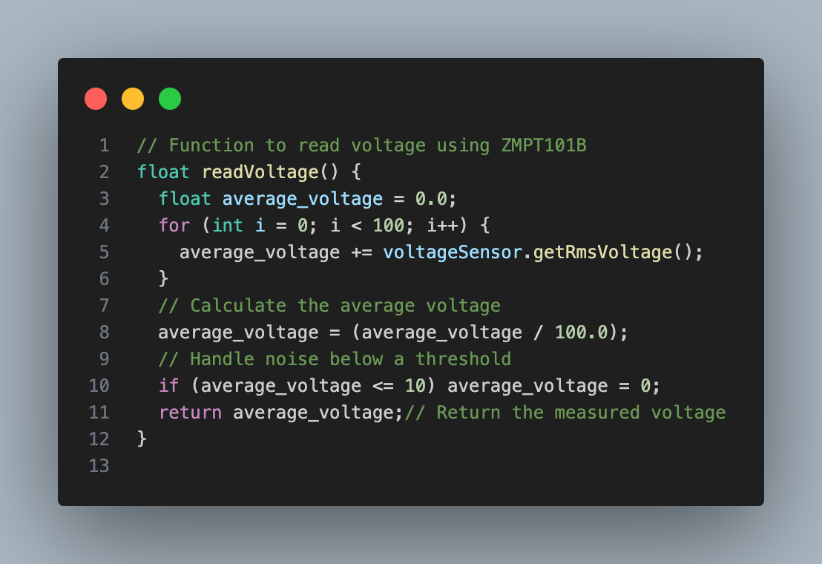
Sample Code Snippet

Slide 9
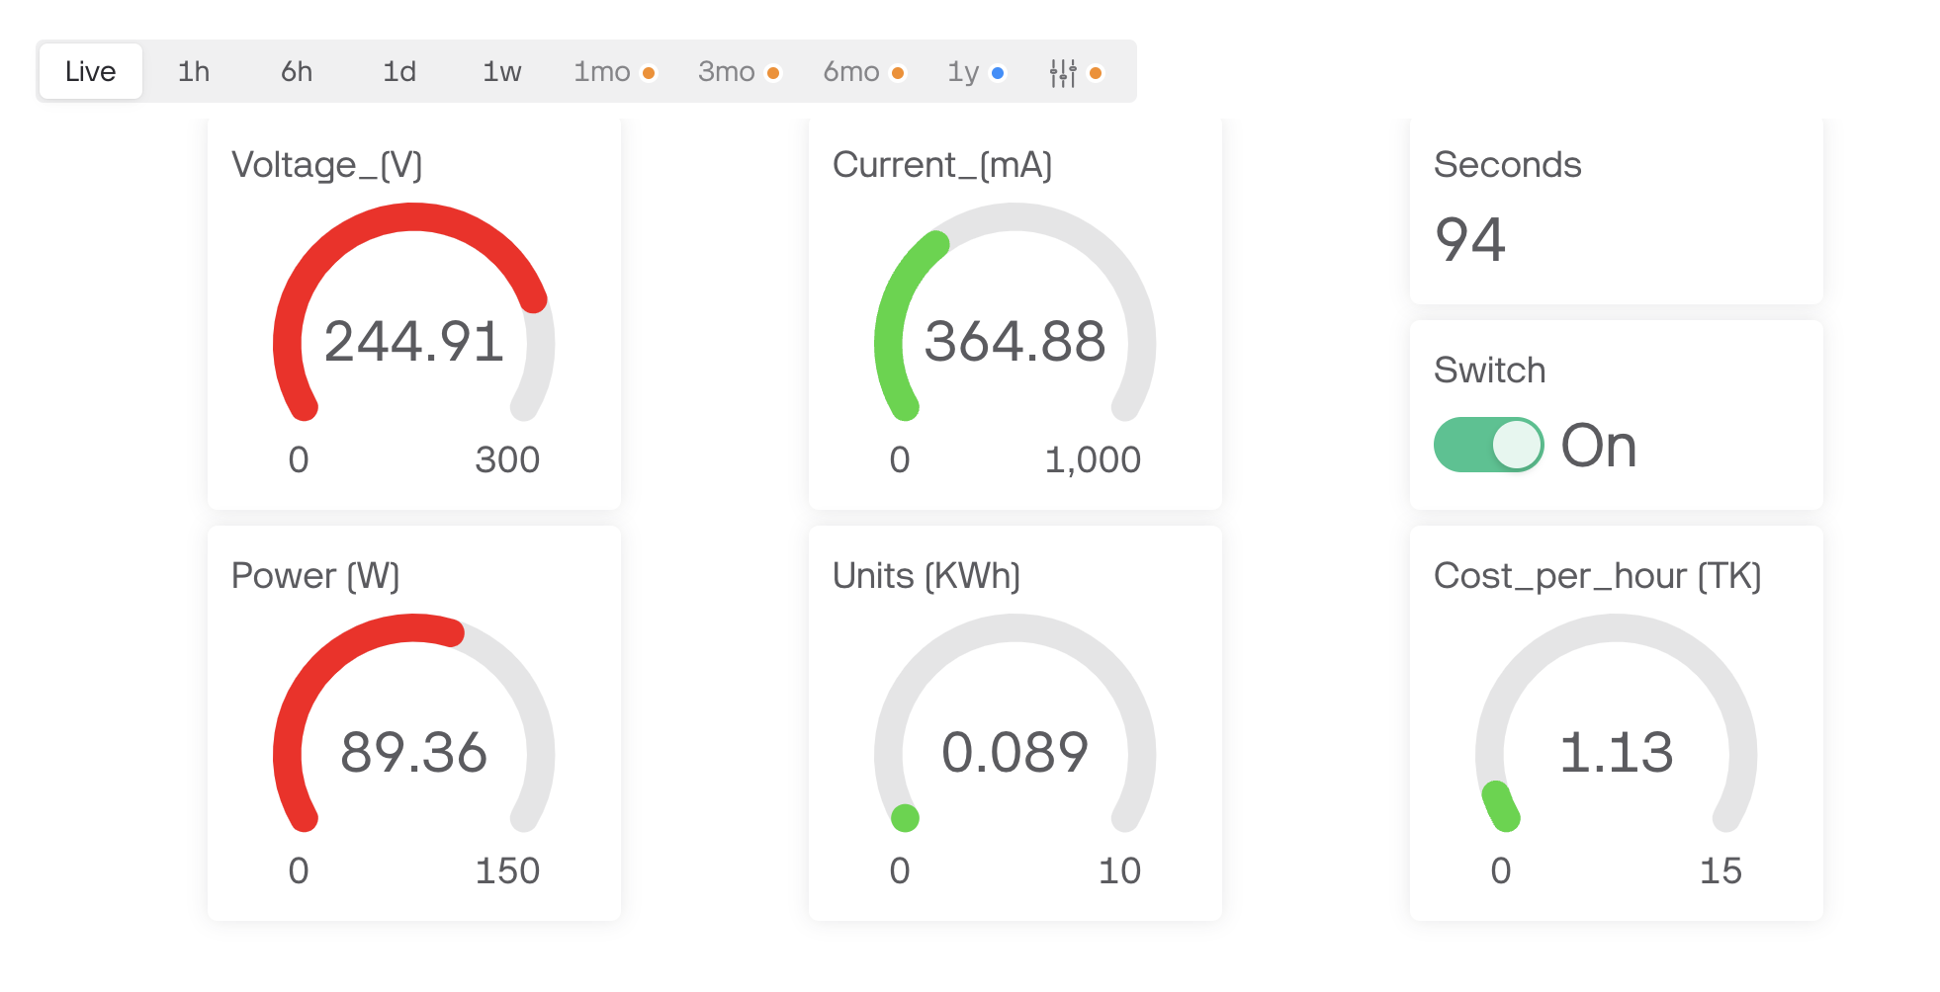
System Features
Real-time energy consumption monitoring.
Cost estimation for electricity usage.
Cloud-based data logging and analysis.
Alerts for high consumption (optional).
Device control with relays (optional).

Slide 10



Real-Life Applications
Monitor household appliances to reduce energy costs.
Manage power usage in offices and factories.
Identify high-energy-consuming devices.
Contribute to sustainable energy practices.

Slide 11

Project Cost Estimate
Component | Cost (BDT)
NodeMCU (ESP32) | 380
CT As ACS 712 30A | 110
PT As ZMPT101B | 160
0.96’’ OLED display | 220
5v 4 channel relay module | 180
Miscellaneous | 802
Total | 1852 (actual 1050)

Slide 12
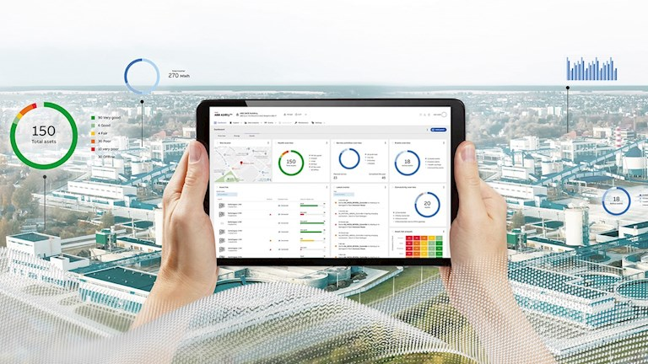
Expected Outcomes
Accurate monitoring of energy consumption.
Cost savings through informed decision-making.
Contribution to energy efficiency and sustainability.

Slide 13



Conclusion
Smart Power Management System empowers users to optimize energy usage.
Helps reduce electricity costs and promotes sustainable practices.
Ready for real-world deployment in homes, offices, and industries.

Slide 14

Questins & Answers

Slide 15


Slide 16

Contact Info
Name : Abdullah Nazmus-Sakib
Phone : 01716260866
E-mail : shakibrybmn@gmail.com
Linkedin : https://www.linkedin.com/in/abdullah-nazmus-sakib-04024b261/
Facebook : https://www.facebook.com/abdullah.nazmus.sakib.2024
GitHub : https://github.com/AbdullahRFA

